Slide 1
TCP
네트워크프로그래밍
휴먼지능정보공학과
201810776 소재휘

Slide 2
Wireshark_TCP_v6.0
Questions (1/4)
What is the IP address and TCP port number used by the client computer (source) that is transferring the file to gaia.cs.umass.edu?
What is the IP address of gaia.cs.umass.edu? On what port number is it sending and receiving TCP segments for this connection?

Slide 3
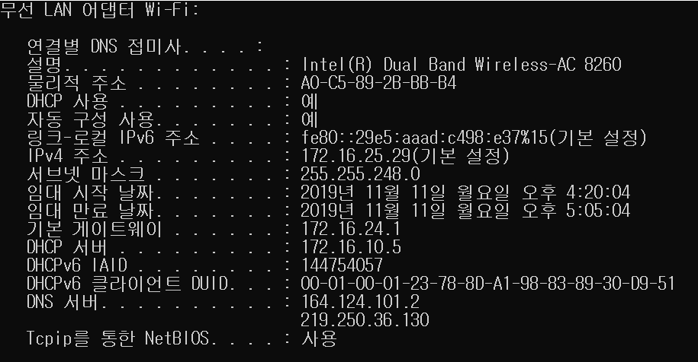
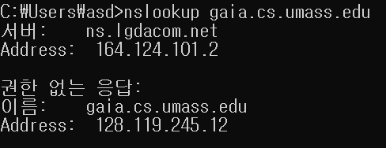
#1 TCP
Network programming
What is the IP address and TCP port number used by the client computer (source) that is transferring the file to gaia.cs.umass.edu?
What is the IP address of gaia.cs.umass.edu? On what port number is it sending and receiving TCP segments for this connection?
Client의 IP address
Gaia server의 IP address

Slide 4
#1 TCP
Network programming
What is the IP address and TCP port number used by the client computer (source) that is transferring the file to gaia.cs.umass.edu?
What is the IP address of gaia.cs.umass.edu? On what port number is it sending and receiving TCP segments for this connection?
Client의 Port Address : 60041
Gaia server의 Port Address : 128.119.245.12

Slide 5
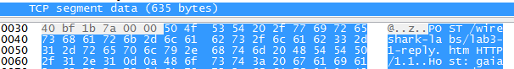
Wireshark_TCP_v6.0
Questions (2/4)
What is the sequence number of the TCP SYN segment that is used to initiate the TCP connection between the client computer and gaia.cs.umass.edu? What is it in the segment that identifies the segment as a SYN segment?
What is the sequence number of the SYNACK segment sent by gaia.cs.umass.edu to the client computer in reply to the SYN? What is the value of the Acknowledgement field in the SYNACK segment? How did gaia.cs.umass.edu determine that value? What is it in the segment that identifies the segment as a SYNACK segment?
What is the sequence number of the TCP segment containing the HTTP POST command? Note that in order to find the POST command, you’ll need to dig into the packet content field at the bottom of the Wireshark window, looking for a segment with a “POST” within its DATA field.

Slide 6
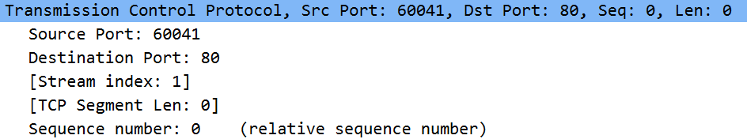
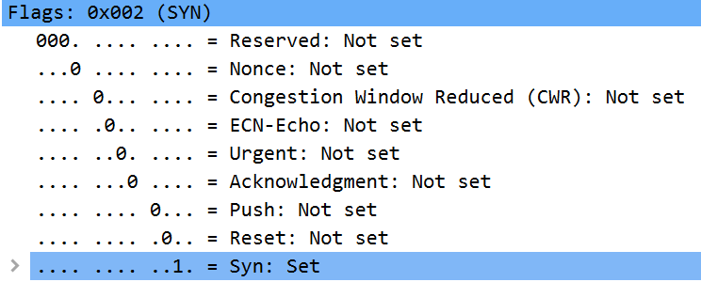
#1 TCP
Network programming
What is the sequence number of the TCP SYN segment that is used to initiate the TCP connection between the client computer and gaia.cs.umass.edu? What is it in the segment that identifies the segment as a SYN segment?
가장 처음의 SYN flag가 포함된 segment를 조사하였다. Sequence number은 0이었고 포함되어 있는 SYN flag로 SYN segment를 식별 가능하다.
Client의 Port Address : 60041

Slide 7
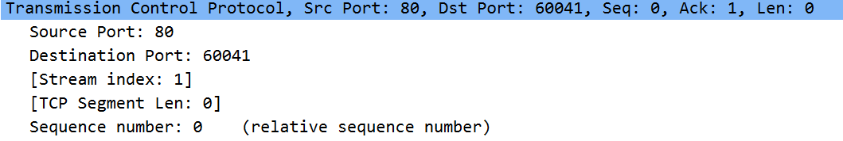
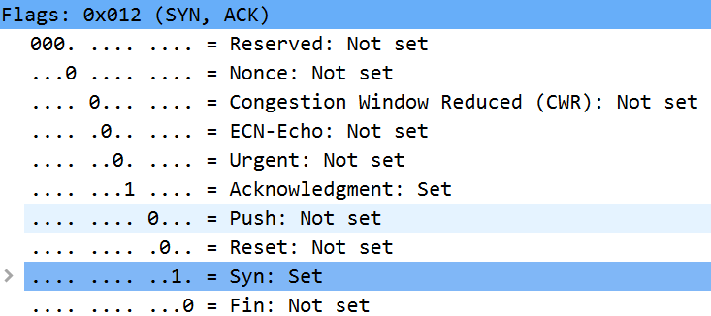
#1 TCP
Network programming
What is the sequence number of the SYNACK segment sent by gaia.cs.umass.edu to the client computer in reply to the SYN? What is the value of the Acknowledgement field in the SYNACK segment? How did gaia.cs.umass.edu determine that value? What is it in the segment that identifies the segment as a SYNACK segment?
Gaia서버가 client에게 reply해준 SYNACK segment를 조사하였다.
Sequence number은 relativ로 0이었고 포함되어 있는 SYN flag와 ACK flag로 SYNACK segmen를 식별 가능하다.
3-way handshake 과정이므로 클라이언트가 SYN을 전달했으므로 그에 대한 답변인 ACK를 포함한다. 즉 전송한 SYN 번호 + 1을 ACK로 전송한다.
Acknowledgment numbe은 다음 패킷의 sequence numbe로 기대되는 1이다.

Slide 8
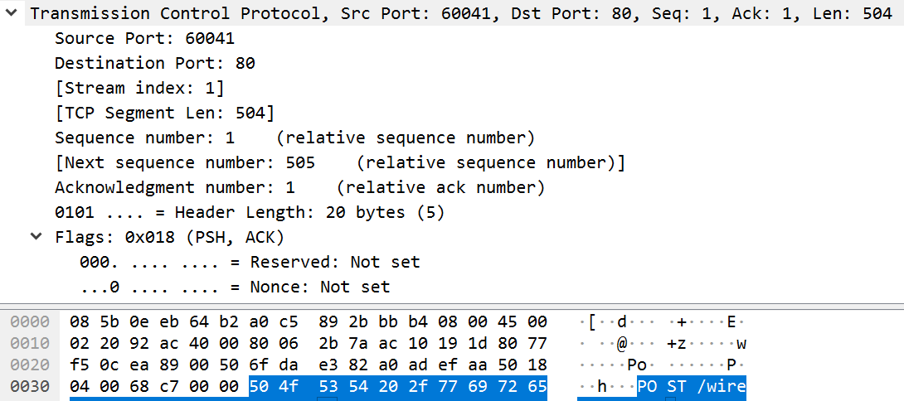
#1 TCP
Network programming
What is the sequence number of the TCP segment containing the HTTP POST command? Note that in order to find the POST command, you’ll need to dig into the packet content field at the bottom of the Wireshark window, looking for a segment with a “POST” within its DATA field.
다음은 HTTP에서 POST명령을 포함하고 있는, 3-way handshake 이후의 첫 data를 포함하고 있는 segment이다. 이 packet의 sequence number은 1이다.

Slide 9
Wireshark_TCP_v6.0
Questions (3/4)
Consider the TCP segment containing the HTTP POST as the first segment in the TCP connection.
What are the sequence numbers of the first six segments in the TCP connection (including the segment containing the HTTP POST)?
At what time was each segment sent? When was the ACK for each segment received?
Given the difference between when each TCP segment was sent, and when its acknowledgement was received, what is the RTT value for each of the six segments?
What is the EstimatedRTT value after the receipt of each ACK? Assume that the value of the EstimatedRTT is equal to the measured RTT for the first segment, and then is computed using the EstimatedRTT equation for all subsequent segments.
Note: Wireshark has a nice feature that allows you to plot the RTT for each of the TCP segments sent. Select a TCP segment in the “listing of captured packets” window that is being sent from the client to the gaia.cs.umass.edu server. Then select: Statistics->TCP Stream Graph->Round Trip Time Graph.

Slide 10
#1 TCP
Network programming
What are the sequence numbers of the first six segments in the TCP connection (including the segment containing the HTTP POST)?
At what time was each segment sent? When was the ACK for each segment received?
Segment를 전송한 시간
Segment를 받은 시간
다음은 HTTP에서 POST명령 이후의 6개의 segment이다. 클라이언트가 서버에 보낸 data의 sequence number은 reply하는 ack 번호와 같은 것을 통해서 보낸 segment에 대한 reply 패킷을 조사할 수 있었고 이를 통해서 Segment를 받은 시간을 알 수 있었다.
각각의 segment의 sequence number은 1,505,1865,3425,4885,6345였다.

Slide 11
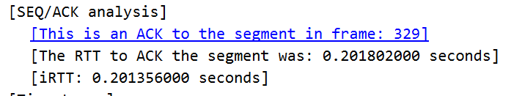
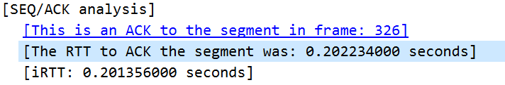
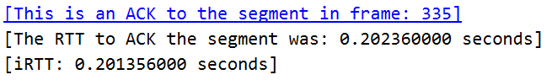
#1 TCP
Network programming
Given the difference between when each TCP segment was sent, and when its acknowledgement was received, what is the RTT value for each of the six segments?
Segment를 받은 시간
RTT value는 segment가 전달되는 시간을 의미한다. 서버가 클라이언트에게 ACK를 보내는 패킷을 통해서 이 값을 확인할 수 있다. 6개의 segment들은 2개의 ack를 받을 수 있었는데 각각의 RTT를 segment 안에서 확인 가능했다.
첫번째 ack는 326번 segment에 대한 응답, 두번째 ack는 327,328,329번, 세번째 ack에서 330,331번에 대한 응답을 포함한다.

Slide 12
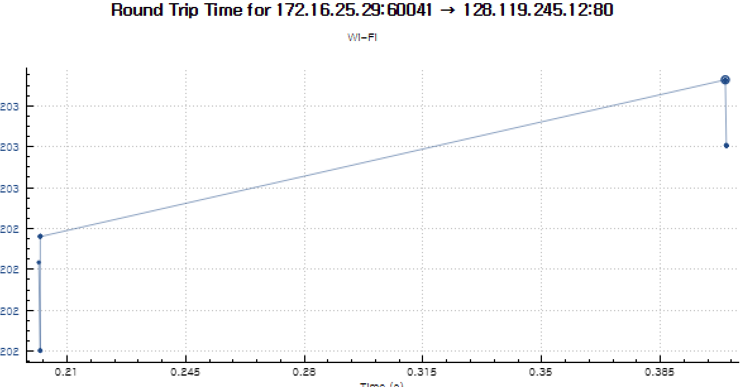
#1 TCP
Network programming
다음과 같이 Wireshark에서 제공하는 툴을 이용해서도 RRT를 확인할 수 있다.

Slide 13
Wireshark_TCP_v6.0
Questions (4/4)
What is the length of each of the first six TCP segments?
What is the minimum amount of available buffer space advertised at the received for the entire trace? Does the lack of receiver buffer space ever throttle(차단 혹은 전송 rate 감소) the sender?
Are there any retransmitted segments in the trace file? What did you check for (in the trace) in order to answer this question?
How much data does the receiver typically acknowledge in an ACK? Can you identify cases where the receiver is ACKing every other received segment (see the table on next page).
What is the throughput (bytes transferred per unit time) for the TCP connection? Explain how you calculated this value.

Slide 14
#1 TCP
Network programming
What is the length of each of the first six TCP segments?
각각 6개의 segment의 length는 504,1460,1460,1460,1460,1460이다.

Slide 15
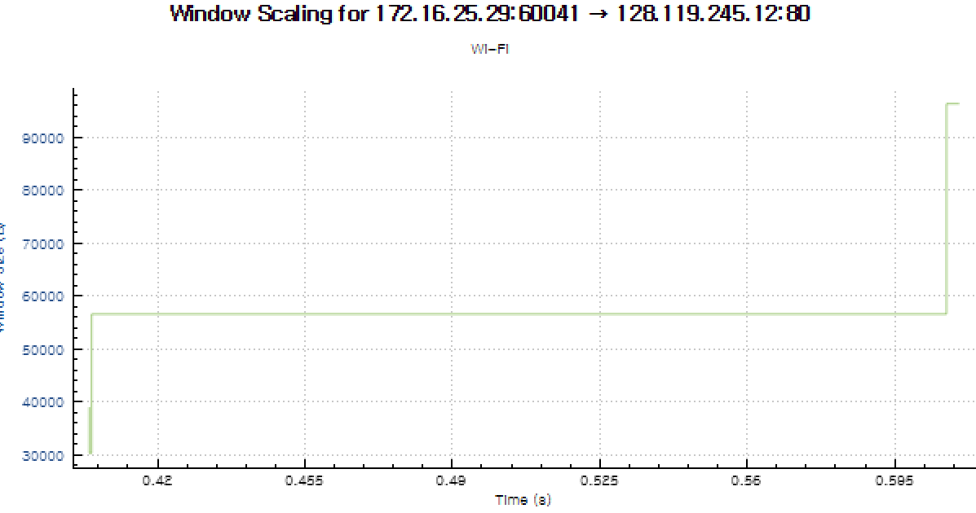
#1 TCP
Network programming
What is the minimum amount of available buffer space advertised at the received for the entire trace? Does the lack of receiver buffer space ever throttle(차단 혹은 전송 rate 감소) the sender?
할당되는 버퍼 사이즈, 즉 Window size는 계속해서 증가하는 추세이다. 즉 Congestion이나 Flow Control을 할 필요가 거의 없다는 것을 의미하고 lost된 패킷도 존재하지 않았다. 최소 Window size 크기는 29200이었다.

Slide 16
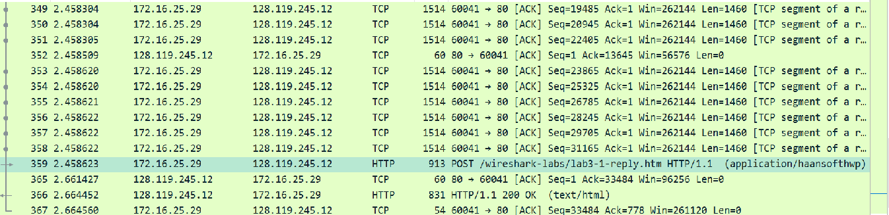
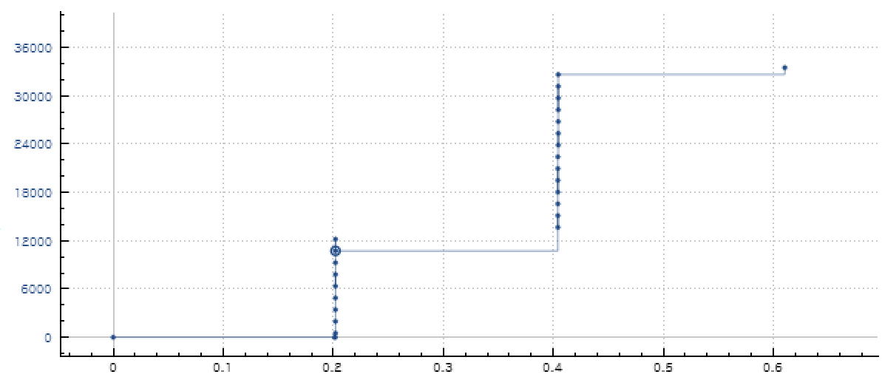
#1 TCP
Network programming
Are there any retransmitted segments in the trace file? What did you check for (in the trace) in order to answer this question?
다음을 확인하면 재전송되는 segment가 하나도 없는 것을 확인할 수 있다. 전송률이 계속해서 올라가는 것을 확인할 수 있다.

Slide 17
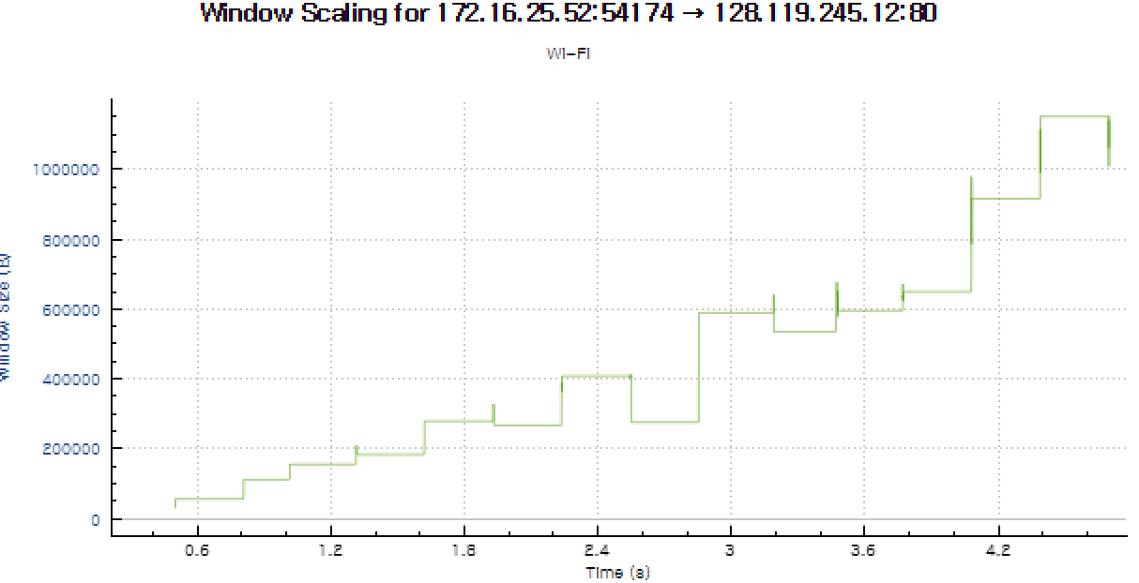
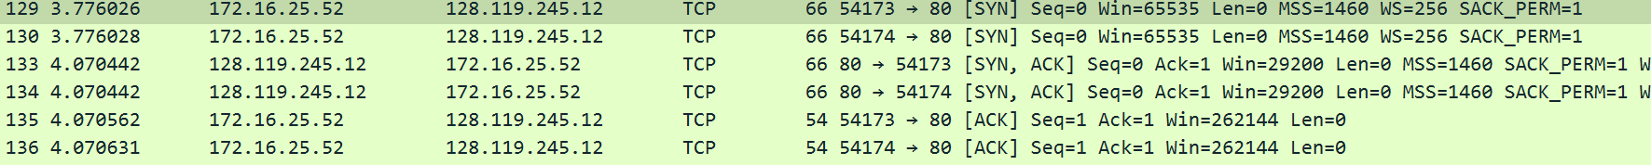
#1 TCP
Network programming
What is the minimum amount of available buffer space advertised at the received for the entire trace? Does the lack of receiver buffer space ever throttle(차단 혹은 전송 rate 감소) the sender?
앞의 결과는 congestion과 flow control을 하는 과정을 관찰이 힘들어 가이아 서버에 큰 파일을 업로드 하였다.
할당되는 버퍼 사이즈, 즉 Window size가 계속해서 조절되고 있다. Congestion이나 flow control을 하기 위해 Window size를 줄였다가 점점 늘이는 과정을 반복하며 버퍼 사이즈를 조절한다.
가장 작은 Window size는 SYN/ACK segment를 보낼 때 29200으로 가장 작았다.

Slide 18
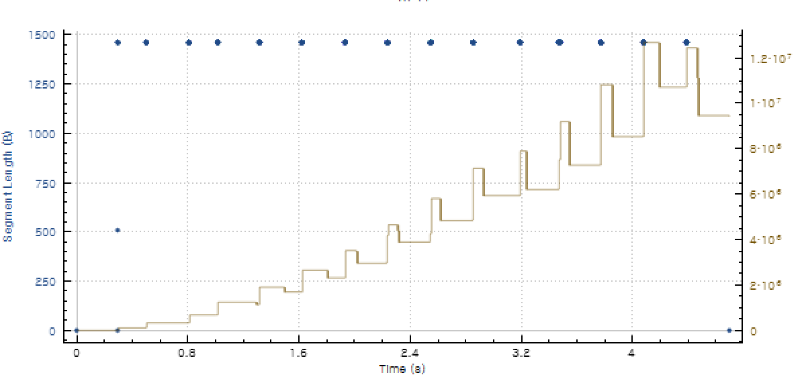
#1 TCP
Network programming
Are there any retransmitted segments in the trace file? What did you check for (in the trace) in order to answer this question?
Throughput을 확인해 보면 처리량이 줄어들었다가 점점 늘어나는 과정을 반복하는 것을 확인할 수 있었다.
이 과정을 통해 Congestion control과
Flow control을 하고 있음을 확인할 수 있다. 그리고 이 과정에서 다음과 같이 버퍼의 용량이 꽉 차서 Segment가 lost된 것도 확인할 수 있다.

Slide 19
#1 TCP
Network programming
How much data does the receiver typically acknowledge in an ACK? Can you identify cases where the receiver is ACKing every other received segment (see the table on next page).
첫번째 ACK는 504byte의 data를 포함하고, 두번째 ACK는 4380byte의 data를 포함하고 세번째 ACK는 8760byte의 data를 포함한다. 앞에서 Window size가 점점 증가하는 것을 확인할 수 있었는데 이에 따라 한 번에 보내는 segment의 양이 증가하고, 그에 따른 ACK의 data가 증가하는 것을 확인했다.
다음의 경우에는 수신자가 다음의 ack가 어떤 segment에 대한 ack임을 식별하는 방법은 Sequence number과 Acknowledge number을 비교함 으로서 알 수 있다. 다음의 경우는 각각의 Segment에 대한 각각의 ACK를 일단 보류하고 일정 수의 Segment들을 묶어서 Ack를 보내는 것을 알 수 있다.

Slide 20
#1 TCP
Network programming
What is the throughput (bytes transferred per unit time) for the TCP connection? Explain how you calculated this value.
다음을 통해서 데이터의 양은 3-way handshake 이후 처음 보내는 sequence number 1의 segment부터 시작한다. 3-way handshake 과정을 포함시키지 않는 이유는 실질적으로 보내는 data가 없기 때문이다. 그리고 connection을 종료하기 전 마지막 data를 보내는 segment에 대한 ACK 번호가 2938029였다. 따라서 2938028byte만큼의 데이터를 전송하였다. 시간은 8.462023-4.070750=4.391273이므로 데이터량/시간을 하여 669060.657이 throughput임을 확인할 수 있다.

